Slide 1

20/22 April 2021
Radford Burger

Slide 2
Agenda
Introduction to Stacks
What’s next?

Slide 3
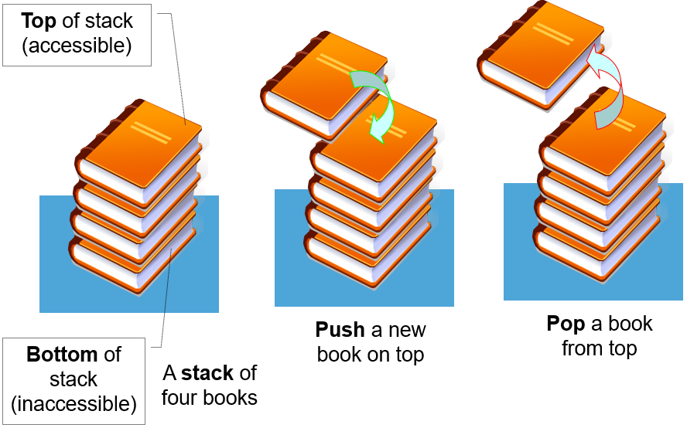
What is a stack?

Slide 4
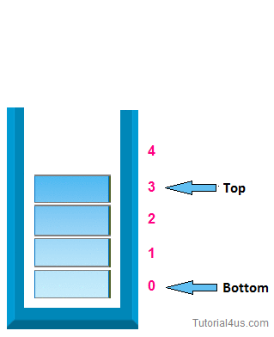
What is a stack?

Slide 5
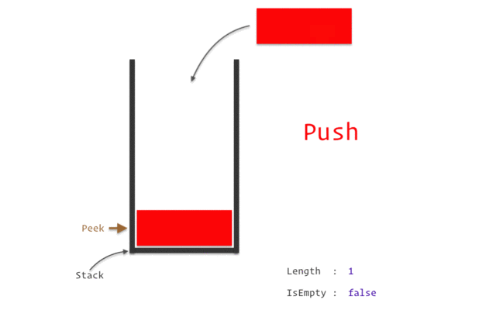
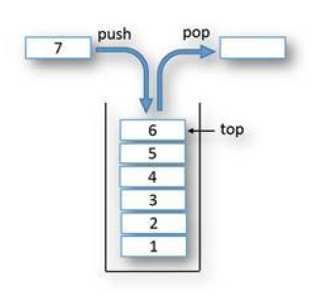
What is a stack?

Slide 6
What is a stack?
A stack is a linear data structure that contains elements , with a sequence and an
order as to how it is constructed and traversed.
If we wanted to add or remove elements from it, we’d have to do it starting from one place:
→ the top of the stack.

Slide 7
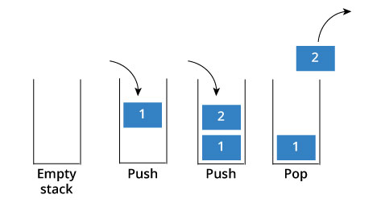
What is a stack?
Stack is a special kind of data structure that follows strategy.
This means that the element that is added to stack last will be the first to be removed
Conversely, this also means that the first element that you put into the stack will always end up being the last one that goes out.
Last-In-First-Out (LIFO)
Example:
As we navigate from web page to web page, the URL of web pages are kept in a stack, with the
current page URL at the top. If we click back button, then each URL entry is popped one by one.

Slide 8

Stack operations
push(k):
Adds a new item to the top of the stack
Remove an element from the top of the stack and return its value.
Returns the value of the element at the top of the stack, but does not remove it
Returns the number of elements in the stack
determines whether the stack is empty. It returns 1(true) if the stack is empty or returns 0 (false) in all other cases.
Note: All the above Stack operations are implemented in Time Complexity.
pop( ):
top( ) or peek( ):
size( ):
isEmpty( ):
O(1) ?
O(1)
O(n) ?

Slide 9
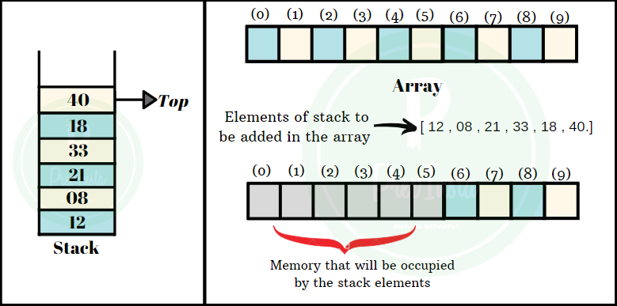
Implementing a Stack using an Array
Since the length of an array is fixed, so is the size of the stack
The top of the stack is managed using an index variable called top

Slide 10
Implementing a Stack using an Array
What is the value of the index top, when the stack is empty?
What is the size of the stack when it is empty?
The index top has a value of -1 when a stack is empty
Stack size is ZERO when stack is empty

Slide 11
Implementing a Stack using an Array
Animation of stack array:
https://www.cs.usfca.edu/~galles/visualization/StackArray.html

Slide 12
Functions when implementing a Stack using an Array
Complete the following method definition:
What is the value of the index top, when the stack is empty?
public boolean isEmpty( ){
}
isEmpty() function returns 1(true) if stack is empty or 0 (false) in all other cases
return (top == -1);
??????????
if (top < 0)
return true;
else
return false;
Alternative →

Slide 13
Functions when implementing a Stack using an Array
Complete the following method definition:
What is the size of the stack when it is empty?
What is the size of the stack after first add (push) operation?
What is the size of the stack after second add (push) operation?
public int size( ) {
??????????
}
return (top + 1);
As top is referring to the array index of the topmost item in the stack, so we need to add one to it.

Slide 14
Let’s look at some code
public class Stack {
private static final int CAPACITY = 1000;
private int[ ] data;
private int top = -1;
public Stack( ) {
this(CAPACITY);
}
public Stack(int capacity) {
data = new int[capacity];
}
}
If user does not provide the max capacity of the array, then an array of 1000 elements is created.
Number of elements in the stack is governed by the “top” index and top is initialized to -1 when a stack is initialized.
Top index value of -1 indicates that the stack is empty in the beginning.

Slide 15
The push() function algorithm
push() function checks whether the stack has enough space to store one more element, then it increases the "top" by one.
Then store the value in the stack "data" array.
In case the stack is full then "stack overflow" message is printed and that value will not be added to the stack and will be ignored.

Slide 16
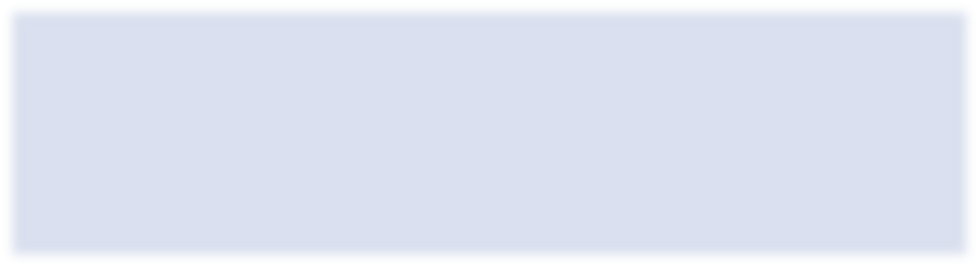
Java for the push() function
public void push(int value) throws IllegalStateException {
if (size( ) == data.length)
throw new IllegalStateException("StackOverflowException");
top++;
data[top] = value;
}

Slide 17
The pop() function algorithm
first check that there are some elements in the stack by checking its top index.
If some element is there in the stack, then it will store the top most element value in a variable “topVal".
The top index is reduced by one.
Finally, that value is returned.

Slide 18
Java for the pop() function
public int pop( ) {
???????????????
???????????????
???????????????
}

Slide 19
The peek() function algorithm
returns the value stored in the top element of stack (does not remove it)

Slide 20
Java for the peek() function
public int peek( ) throws IllegalStateException {
???????????????
???????????????
???????????????
}

Slide 21
The print() function
The print function will print the elements of the stack array.
public void print( ){
???????????????
???????????????
}

Slide 22
In your main method
· The user of the stack will create a stack local variable.
· Use push() and pop() functions to add / remove variables to the stack.
· Read the top element using the peek() function call.
· Query regarding size of the stack using size() function call
· Query if stack is empty using isEmpty() function call

Slide 23
What’s next?
Implementing a Stack using a Linked List

